Slide 1
A Fundamental Trade off Between Computation and Communication in Distributed Computing
BY : ARYA TOPALE (2022102052)
YASH BHUTADA(2022102049)

Slide 2
WHAT IS DISTRIBUTED COMPUTING?
Distributed computing is a method of making multiple computers work together to solve a common problem. It makes a computer network appear as a powerful single computer that provides large scale resources to deal with complex challenges.
Distributed computing can encrypt large volumes of data.
The distributing computing framework is motivated by structures like Map Reduce and Spark.

Slide 3
WHAT IS MAP REDUCE?
The distributed computing framework is motivated by two functions/structures-Map, Reduce.
The Map Phase-distributed computing nodes process data locally and then they generate some intermediate values. Each chunk of data is processed according to its Map Function. Now there is an intermediate step just after the Map phase that is the shuffle phase. The calculated intermediate values are exchanged among the various computing nodes.
Reduce Phase-The final values after shuffling is calculated in this phase.

Slide 4
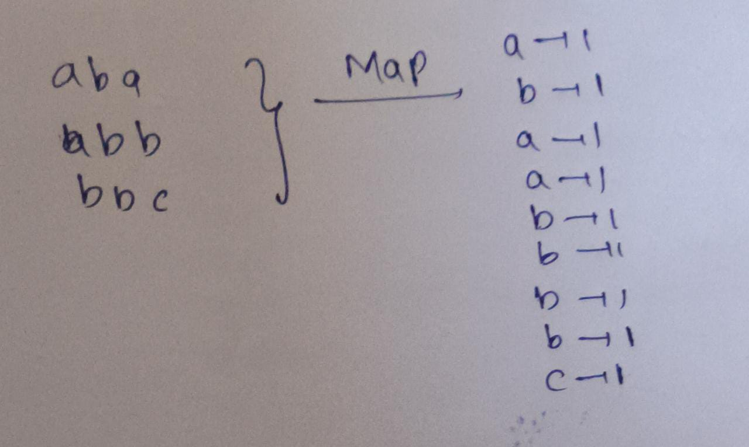
CHALLENGES DUE TO DATA SHUFFLING
The data shuffling phase, which is the intermediate phase between map and reduce, is often a time consuming step. For example, let us consider an example of three strings aba, abb, bbc and the mapping occurs on the basis of the alphabet count in the string file.
Now the map phase will look like-

Slide 5
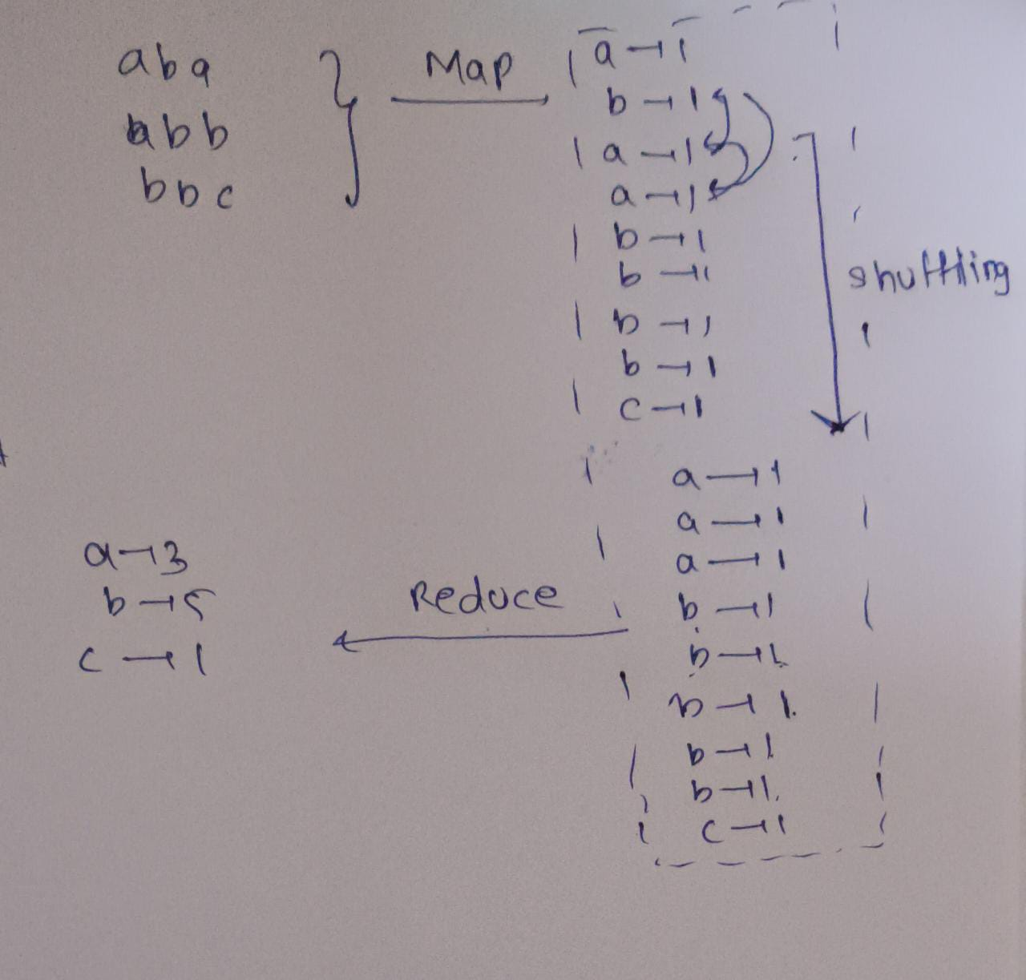
THE SHUFFLING PHASE-LETS HAVE A LOOK
As we can see, the shuffle phase involves a lot of steps in it, so it is very time consuming and it limits the performance of distributed computing systems.
Now we have an important question to answer, can coding reduce the load of communication on distributed computing and can it speed up the overall process? We extend the application of coding to substantially reduce the load of data shuffling via coding and some extra computing in Map phase.

Slide 6
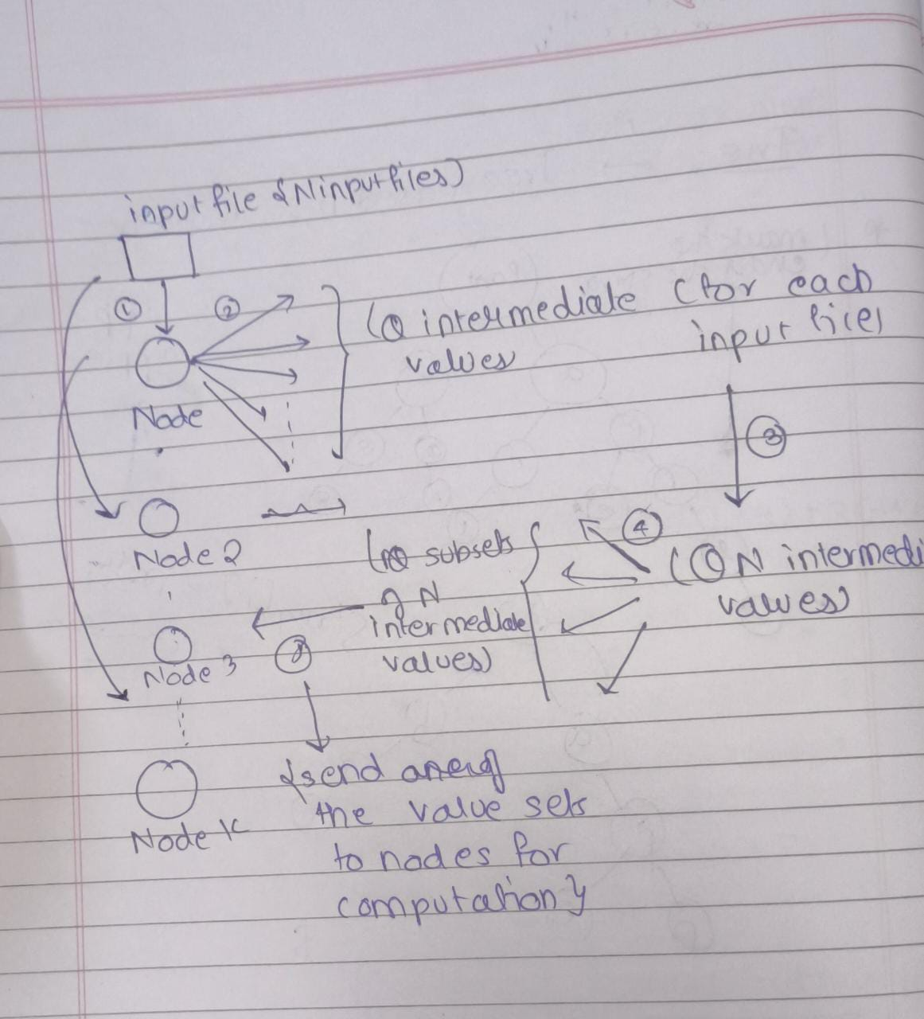
An example of computing using MapReduce
Here N is the number of input files, K is the number of nodes which are computing nodes. and Q is the number of intermediate values which are produced.

Slide 7
Computation Load(r)
The computational Load(r) is the total number of computed Map functions at the nodes. Now, for example if r=1, then none of the map function has been re computed, r=2, then on an average each Map function can be computed on two nodes.
Coded Distributed Computing- It is defined as L(coded)=(1/r)(1-r/K).
This coding scheme employs a specific strategy to assign computations of Map and Reduce functions across the computational nodes which will allow good coding opportunities for data shuffling. What CDC does is it repetitively maps the data blocks at r distinct nodes to create coded messages that deliver data simultaneously to a subset of r>=1 nodes.

Slide 8
PROBLEM FORMULATION
Let us formulate this problem. Consider Q arbitrary output functions which need to be computed from N input files and we have K computing nodes. All these belong to the set of Natural Numbers.
Let the N input files be w1,w2,w3,w4,w5,w6....wn. Now, each input file belongs to a field with length of each mapping to be 2^{F}, where F is some number belonging to N.
Now we need to compute the output functions Ø_{p}:(F₂^{f})^{N} -->F₂^{B} .
This function maps each input file to a stream of bits (0,1) which are of length B.
Roles-The Map function Maps the input files to Q T length intermediate values(Binary) that is F₂^{F}--->F_{2^T(power).} In the reduce function, all these Q intermediate values of the output function are mapped to B length binary streams.
This is carried out by K computating Nodes and all of them are interconnected through a network.

Slide 9


Slide 10
DETAILED AND MATHEMATICAL DESCRIPTIONS OF EACH PHASE-
Map Phase-This phase computes the Map functions of M_{k} for a set of files, now M_{k} can be said to be a design parameter. For every file in M_{k}, Node k computes the map functions and maps it to intermediate values. Our assumption here is each file is mapped by atleast one node .
Computational Load(r)- total number of Map functions computed by all the K nodes divided by total number of input files, intuitatively we can say that it is the average number of nodes which map each file.
Shuffle Phase-Now we have K nodes, each node is responsible to compute a subset of the output functions, the index of any function denoted as W_{k}-->subset of {1,2......Q}.
Now, if there are K nodes, and Q output functions then we can symmetrically distribute the task among the K nodes as Q/K which will be the size of the subset of output functions denoted by W_{k}. This will maintain load balance.
This will also ensure W_{i} intersection W_{j}={null}.

Slide 11


Slide 12
Now, in order to compute the output function u_{q}, Node k will be needing intermediate values which are not computed in the Map phase locally. After the K nodes finishes mapping all the Map functions in M_{k}, the K nodes start shuffling the intermediate values among themselves, in order to bring the same kind of data together. We can give this as an analogy like a dictionary which maps keys to its values.
Now, each node assigns a particular code word/input symbol X_{k} which belongs to F₂^{l}_{k} for some l_{k} belonging to Natural numbers, this lk is the length of the code word/input symbol.

Slide 14


Node k will transmit this message to all the other nodes. The shuffle phase ensures that each of the node receives this codeword without any error.
Reduce Phase- In this phase the input/code symbols are used along with the locally computed results from the map phase
In the reduce function a reducing/decoding function is used:
to compute each of the encoded symbol. Now this node k computes the reduce function for uq for some q belonging to belonging to the index set Wk.

Slide 15
FEASIBILITY
Communication Load-The communication load is defined as L=summation(l(i))/QNT where i varies from 1 to K. Now we know that QN intermediate values are produced, and each intermediate value will length T, so the total number of bits taken will be QNT, also the length of each code word assigned is l(i) which is different for every node, so the total number of bits consumed for every code word will be the total summation. Therefore communication load can be said to be the normalized total number of bits communicated by the K nodes during shuffle phase
Consider a tuple of computation factor(r) which can be said to be the amount of the total computational power required and the communication factor which can be said to be the total information exchanged.
We can say that this tuple is feasible if for any given small positive value delta-

Slide 16


Slide 17

FEASIBILITY
The difference between original computational requirement and new computational requirement is within this small tolerance, and the same goes for the communication load. That is, a very minute change in r and L will result in very minute change in the overall computation of the functions., I.e. the encoding and decoding functions etc.
Uncoded scheme-It is a direct scheme which does not account for error correction, while in coded scheme there is data redundancy which leads to error correction.
The communicational load for uncoded scheme is L=1-r/k.

Slide 18
Now, in the above case, we have a fixed and symmetric file assignment to nodes, this means that the intermediate values of the output functions are distributed across the nodes in a predetermined method, and the reduce function assignment is same for all the nodes.
Therefore, we can say that the symmetric assignment of Reduce functions and the fixed file assignment can satisfy our data conditions. The only change in the intermediate phase is that we need to ensure a transfer of data between the nodes such that each node has the necessary data for its assigned Reduce functions. As the assignment is symmetric, we can say that the communication load is independent of the assignment of the reduce functions and the only change that may occur is renumbering the reduce functions assigned to each node.

Slide 19
MAIN RESULTS
The computation communication function of the distributed framework is given by-
This formula can be stated for sufficiently large values of T. When T is large, it signifies that the intermediate values being processed in distributed computing framework are of substantial size and complexity, ensuring that analysis becomes easy and the calculations are not trivial. For general values of T, L*(r) is the lower convex envelope of the points {r,L}

Slide 20


Slide 21
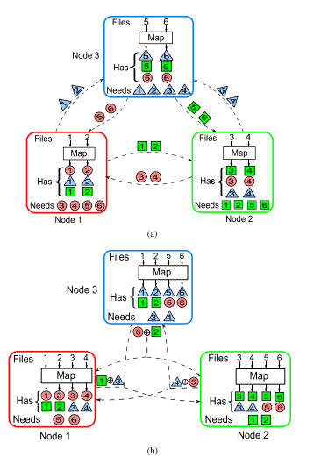
Examples of Coded distributed computing

Slide 22
Contributions :
Manim animations – Yash Bhutada
PPT making – Arya Topale
Data collection – Both
Presentation - Both

